Slide 1
Credit card financial Report using power bi
Naga Pavan Kumar

Slide 2
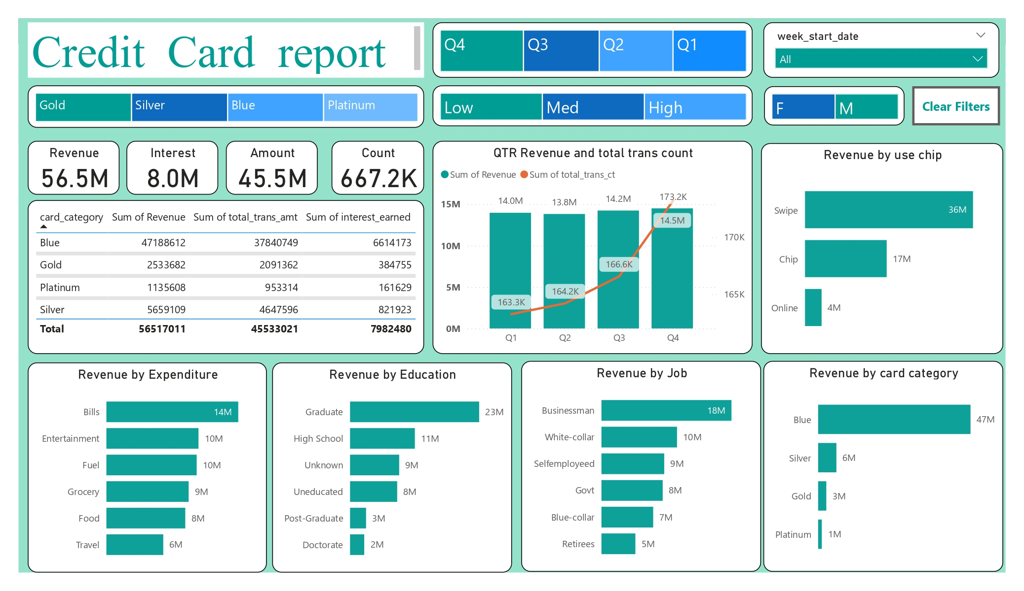

Slide 3
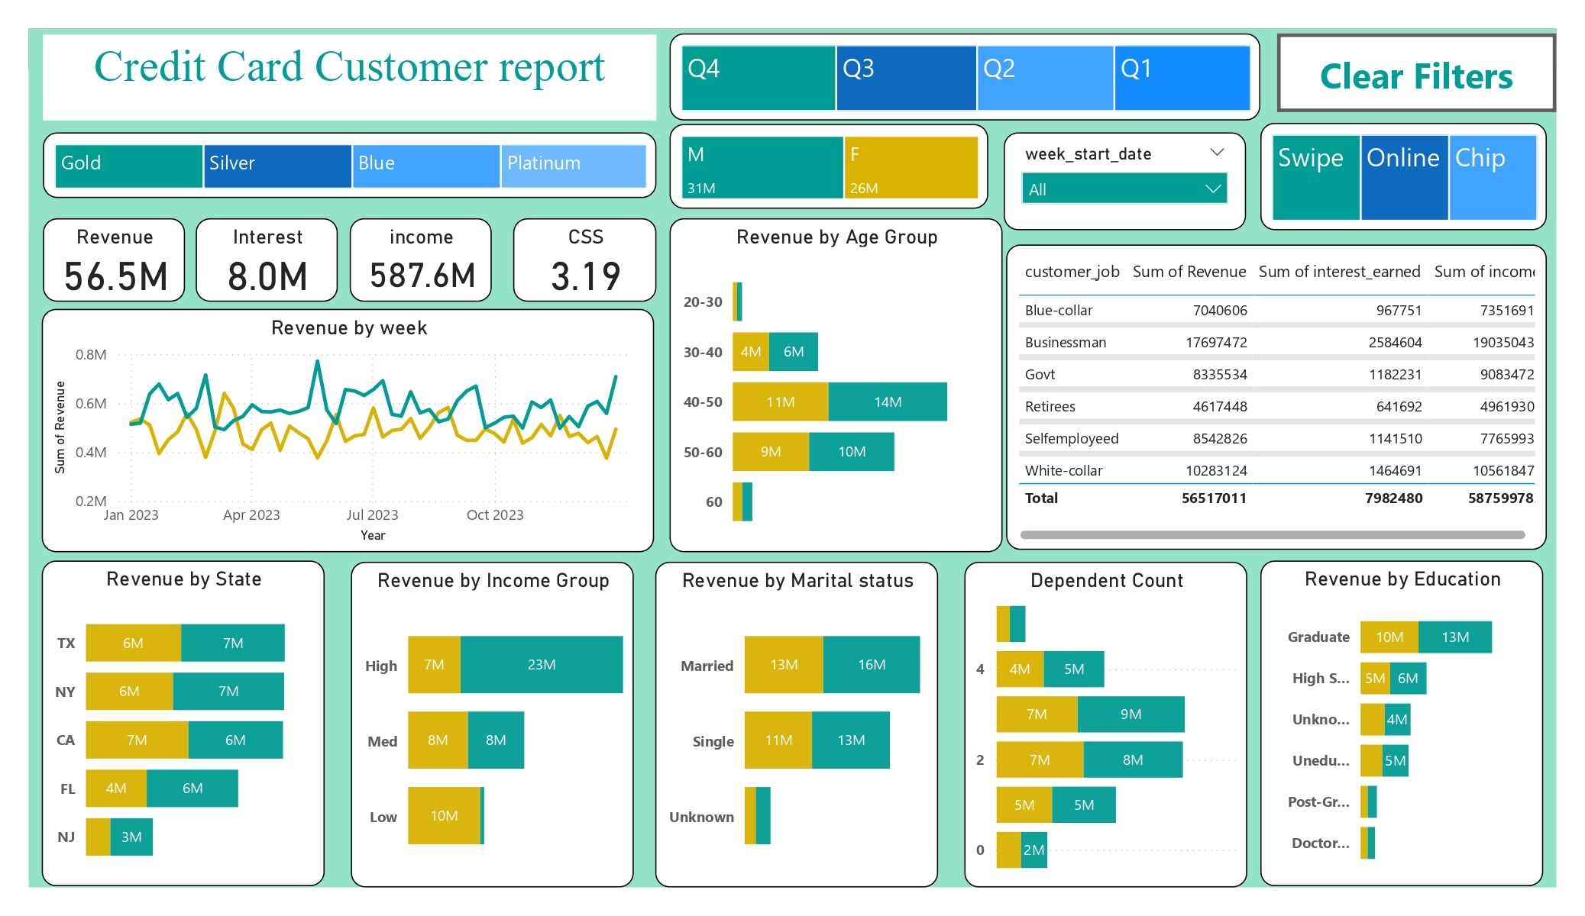

Slide 4
DAX Queries
1.To get the week num to sort the week
week_num2 = WEEKNUM('public cc_detail'[week_start_date])
Revenue = 'public cc_detail'[annual_fees] + 'public cc_detail'[total_trans_amt] + 'publiccc_detail'[interest_earned])
2. To get the current week revenue
Current_week_Reveneue = CALCULATE(
SUM('public cc_detail'[Revenue]),
FILTER(
ALL('public cc_detail’),
'public cc_detail'[week_num2] = MAX('public cc_detail'[week_num2])))
3. To get the previous week revenue
Previous_week_Reveneue = CALCULATE(
SUM('public cc_detail'[Revenue]),
FILTER(
ALL('public cc_detail’),
'public cc_detail'[week_num2] = MAX('public cc_detail'[week_num2]) -1))

Slide 5
DAX Queries
4. Customers by Age segregation
AgeGroup = SWITCH(
TRUE(),
'public cust_detail'[customer_age] < 30, "20-30",
'public cust_detail'[customer_age] >= 30 && 'public cust_detail'[customer_age] < 40, "30-40",
'public cust_detail'[customer_age] >= 40 && 'public cust_detail'[customer_age] < 50, "40-50",
'public cust_detail'[customer_age] >= 50 && 'public cust_detail'[customer_age] < 60, "50-60",
'public cust_detail'[customer_age] >= 60, "60+",
"unknown"
)
5. Customers by Income segregation
IncomeGroup = SWITCH(
TRUE(),
'public cust_detail'[income] < 35000, "Low",
'public cust_detail'[income] >= 35000 && 'public cust_detail'[income] <70000, "Med",
'public cust_detail'[income] >= 70000, "High",
"unknown“
)

Slide 6
Project Insights- Week 53 (31st Dec)
WoW change:
Revenue increased by 28.8%,
Total Transaction Amt & Count increased by 35.04% & 3.39%
Customer acquisition cost increased by 16.32%
Overview YTD
Overall revenue is 57M
Total interest is 8M
Total transaction amount is 46M
Male customers are contributing more in revenue 31M, female 26M
Blue & Silver credit card are contributing to 93% of overall transactions
TX, NY & CA is contributing to 68%
Overall Activation rate is 57.5%
Overall Delinquent rate is 6.06%

Slide 7
